Slide 1
Peer Review
Diego Perez-Liebana
Simon Lucas

Slide 2
Today
Why Peer Review?
The Peer Review process
Reviewing a paper

Slide 3
Why Peer Review
Peer Review is at the heart of the scientific method.
It provides the assurance that an expert has double-checked your work before granting publication.
How does it work?
One or more authors write up a study to report their findings, and submit it to a conference/journal
The editors of the conference/journal send the manuscripts to other scientists that work on the same field
The reviewers provide feedback on the article and suggest if the paper should be accepted, revised or rejected.
And then… depends on the model.

Slide 4
Models by Identity
Single Blind Peer Review
Authors do not know who reviewers are
Reviewers know who the authors are
Pros:
Anonymity allows for honest review
Knowing the authors’ track record helps assess believability
Cons:
Knowing the author can overshadow the quality of the work
Discrimination (nationality, gender, race) and bias become possible
Example: IEEE Computational Intelligence in Games (CIG)

Slide 5
Models by Identity
Double Blind Peer Review
Authors do not know who reviewers are
Reviewers do not know who the authors are
Pros:
No bias
Anonymity
Cons:
Anonymity is not guaranteed (sometimes it’s easy to guess)
Not knowing authors’ track record may prevent from a more informed judgement
Example: ACM Foundations on Digital Games (FDG)

Slide 6
Models by Identity
Open Peer Review
Identity of authors and reviewers are known by everybody
May include identities during the process;
or be established as a Post-publication peer review: reviews after publication in a public open forum
Pros:
Transparency
Reviewers are more rigorous
Cons:
No anonymity on reviewers may bias review
Reviewers may not be comfortable / refuse to review senior researchers’ work.
Example: F1000Research (https://f1000research.com/faqs)

Slide 7
Models by Process
One shot: reviews returned with final decision (IEEE CIG)
Rebuttal as comment: authors refute reviews via comments before final decision (ACM FDG)
Response and resubmission:
editor returns decision: accept / minor revisions / major revisions / reject
Authors resubmit (if applicable) addressing reviewers concerns in a separate letter
Process can be iterated many times
Examples: IEEE ToG, ICLR

Slide 8
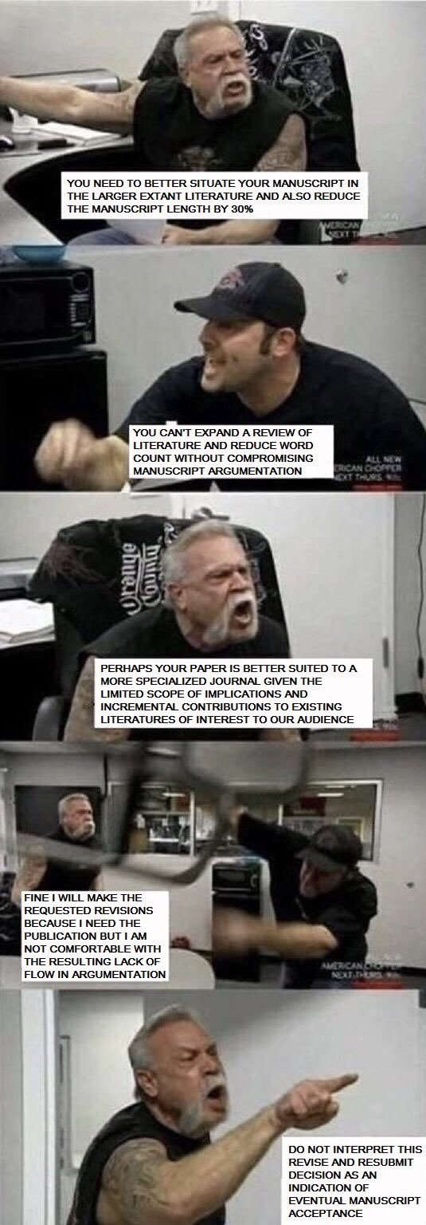

Slide 9
The Peer Review process
The peer-review process is meant to guarantee:
Only articles that meet good scientific standards are accepted for publication.
The methods are appropriate.
Results are accurate and properly interpreted.
There is a solid and relevant body of related work described.

Slide 10
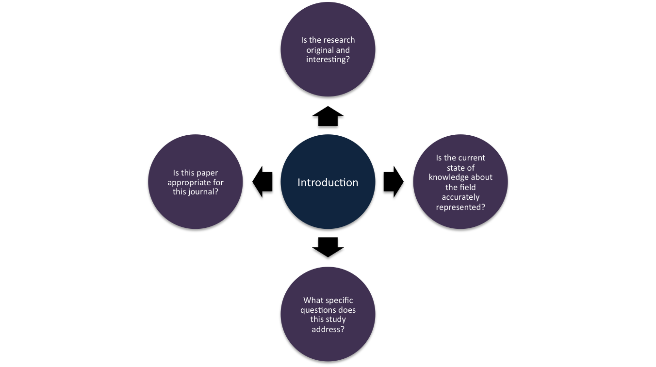
Reviewing a paper

Slide 11
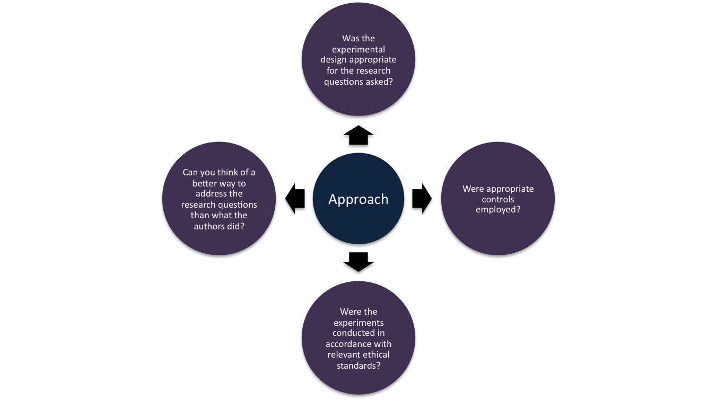
Reviewing a paper

Slide 12
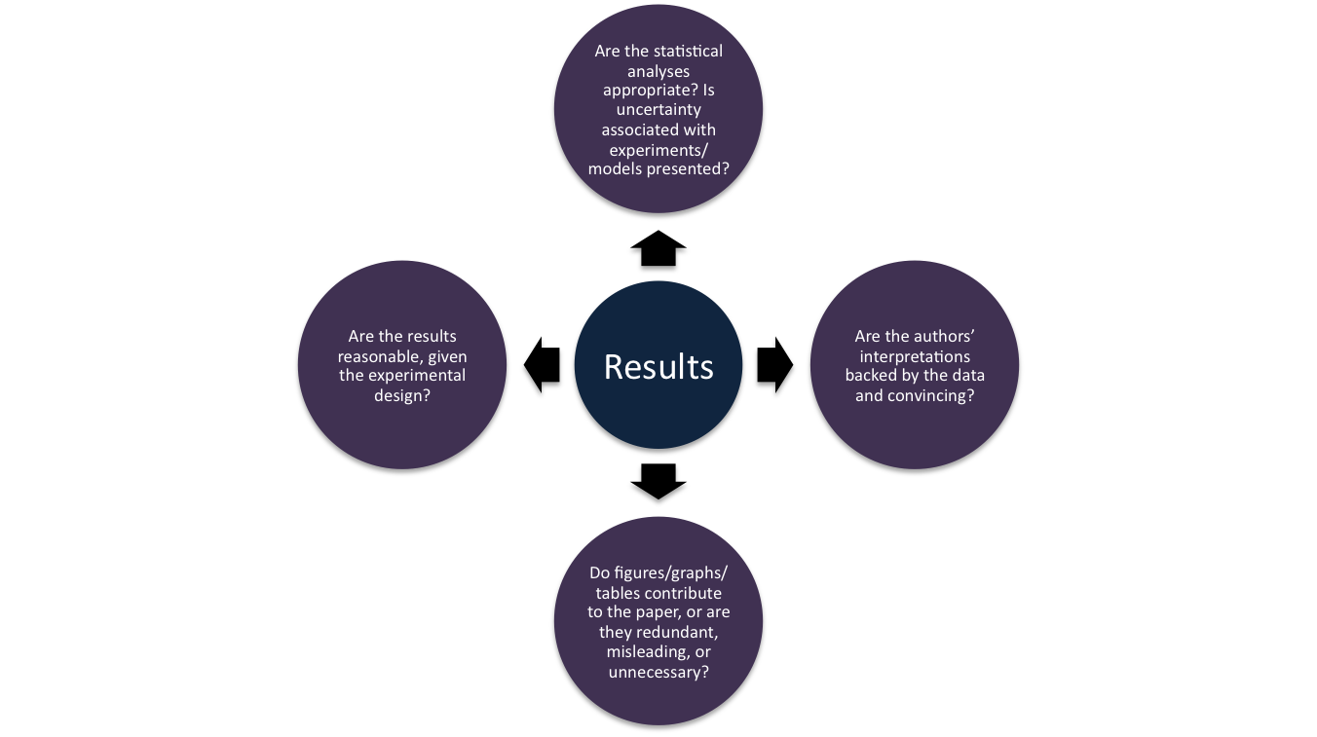
Reviewing a paper

Slide 13
Reviewing a paper
Other considerations:
Are results replicable?
Is data / source code available?
Are all figures/tables understandable and readable
Is the paper free of grammatical mistakes / typos
Any other ways to improve the paper?

Slide 14
Reviewing a paper
Ethical considerations
Expertise: does the paper fall within your area of expertise?
Time: dedicate time and return review on time.
Rigorousness: do a thorough review for the sake of the authors, conference/journal and the scientific field.
Watch conflict of interests (either positive or negative bias)
No intimidation: Your review counts the same as the one from a senior academic. Also if (s)he is an author!
You can sign your review!
Respect confidentiality – the manuscript is for your eyes only!

Slide 15
Reviewing a paper
And more qualities!
Correctness: results and proofs must be correct
Significance: results and problems are not trivial
Innovation: study is original and not trivial extensions
Motivation: study should be relevant to the community
Timeliness: work contextualized in recent and/or relevant literature
Succinctness: the paper should be concise and to the point, avoiding obfuscation, jargon and digression
Accessibility: standard notation and (relatively basic) method explanations should be present
Readability: the paper should be easy to read with minimum effort

Slide 16
Reviewing a paper
This is the ideal peer-review process.
But sometimes reviewing goes wrong…
Reviewer clearly didn’t understand the paper
Reviews are too short
Reviews can be contradictory
Reviews are voluntary (most cases): time constraints prevent you from doing a completely thorough work. But you need to be as fair as possible!

Slide 17
Sources (for above and more)
Types of Peer Review
https://authorservices.wiley.com/Reviewers/journal-reviewers/what-is-peer-review/types-of-peer-review.html
What is open peer review? A systematic review
https://www.ncbi.nlm.nih.gov/pmc/articles/PMC5437951/
Open Peer Review Characteristics Comparison.
https://www.ncbi.nlm.nih.gov/pmc/articles/PMC4350441/table/T1/
ICLR Peer Review System
https://iclr.cc/Conferences/2018/CallForPapers

Slide 18
Sources (for above and more)
How to become good at peer review: A guide for young scientists
https://violentmetaphors.com/2013/12/13/how-to-become-good-at-peer-review-a-guide-for-young-scientists/
Scrutinizing science: Peer review
https://undsci.berkeley.edu/article/howscienceworks_16
Retraction Watch
https://retractionwatch.com/page/3/
A Guide for New Referee s in Theoretical Computer Science
http://www.jmlr.org/reviewing-papers/p92-parberry.pdf
Ethical Guidelines for Peer Reviewers
http://publicationethics.org/files/u7140/Peer%20review%20guidelines.pdf

